Slide 1
LECTURE 01: INTRODUCTION TO
VISUAL ANALYTICS
February 16, 2021
CSC/SDS 235
Visual Analytics

Slide 2



Introductions
Jordan
(he/him) Instructor
Ananda
(she/her)
TA / Liaison / SICS
Kshiti
(she/her) Grader / UMass MS

Slide 3





What I do: analytical tools for messy data

Slide 4
Interesting (non-CS) thing to know about me
my hobby: marine aquaculture
(raising coral & anemones)

Slide 5

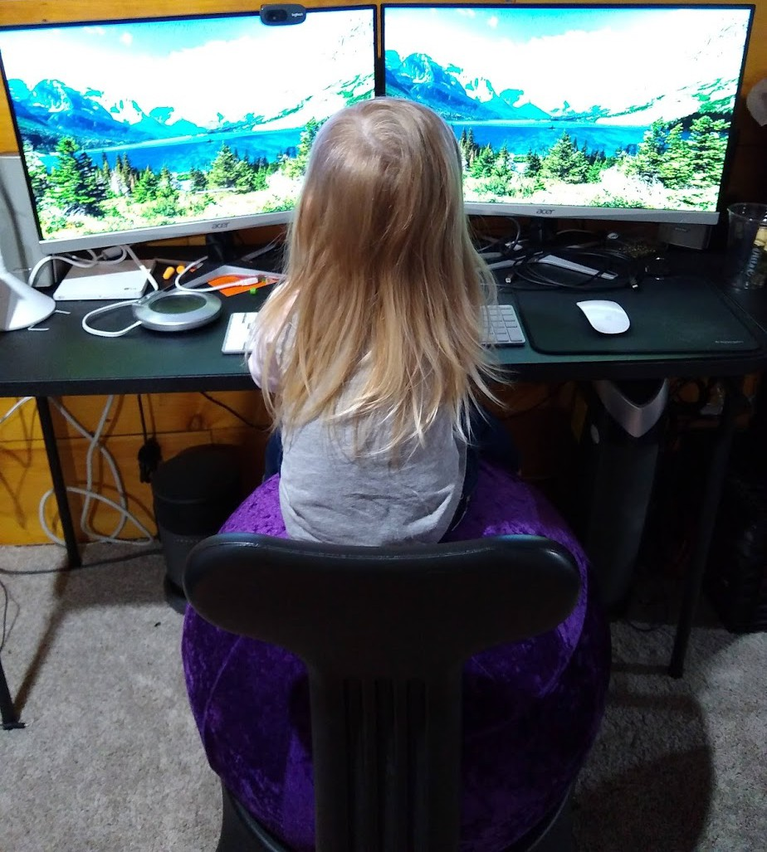
Way more interesting thing
“…I’ll probably come to visit later this semester,
I have lots of thoughts about
computer science!”
Logan
(3.5 years old)

Slide 6
3-minute biographies
About you:
Your name and pronouns
Your year, school, and major / area of focus
Technical background (CSC / SDS)
3 questions:
What brought you to this course?
What’s one big thing you hope to get out of it?
What’s one problem / idea / curiosity that sometimes keeps you up at night?
tinyurl.com/CSC235-bios

Slide 7
Backtrack: analytical tools for messy data

Slide 8
The problem
We’re collecting and generating data faster than traditional methods can keep up
Not only is the data unmanageably big, it’s usually
noisy and ambiguous too ➔ requires interpretation
Major problem: humans don’t scale

Slide 9
Outline
Introductions
Big problem
Quick history lesson
Visual analytics: definition
Discussion: how does it help?
Structure of this course

Slide 10

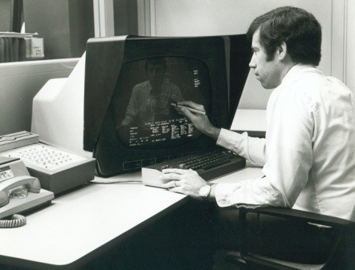
(Incomplete) History of Visual Analytics: 1970s
CAD/CAM, building cars, planes, chips
Starting to think about: 3D, animation, edu, medicine

Slide 11

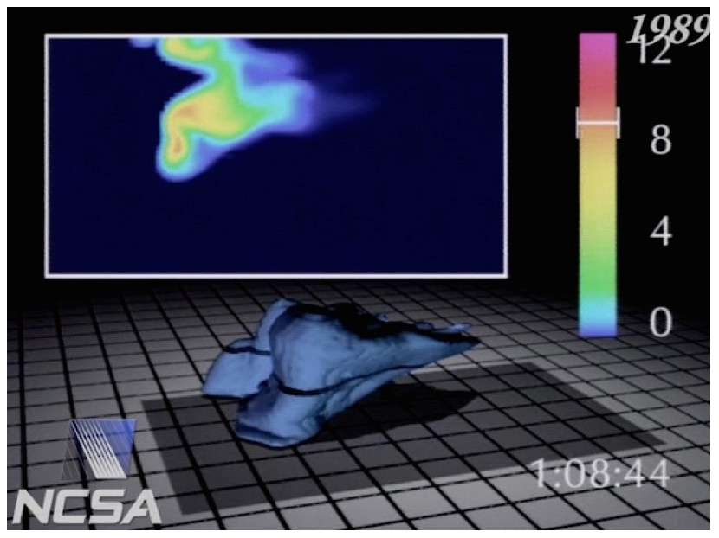
(Incomplete) History of Visual Analytics: 1980s
Scientific visualization, physical phenomena
Starting to think about: photorealism, entertainment

Slide 12
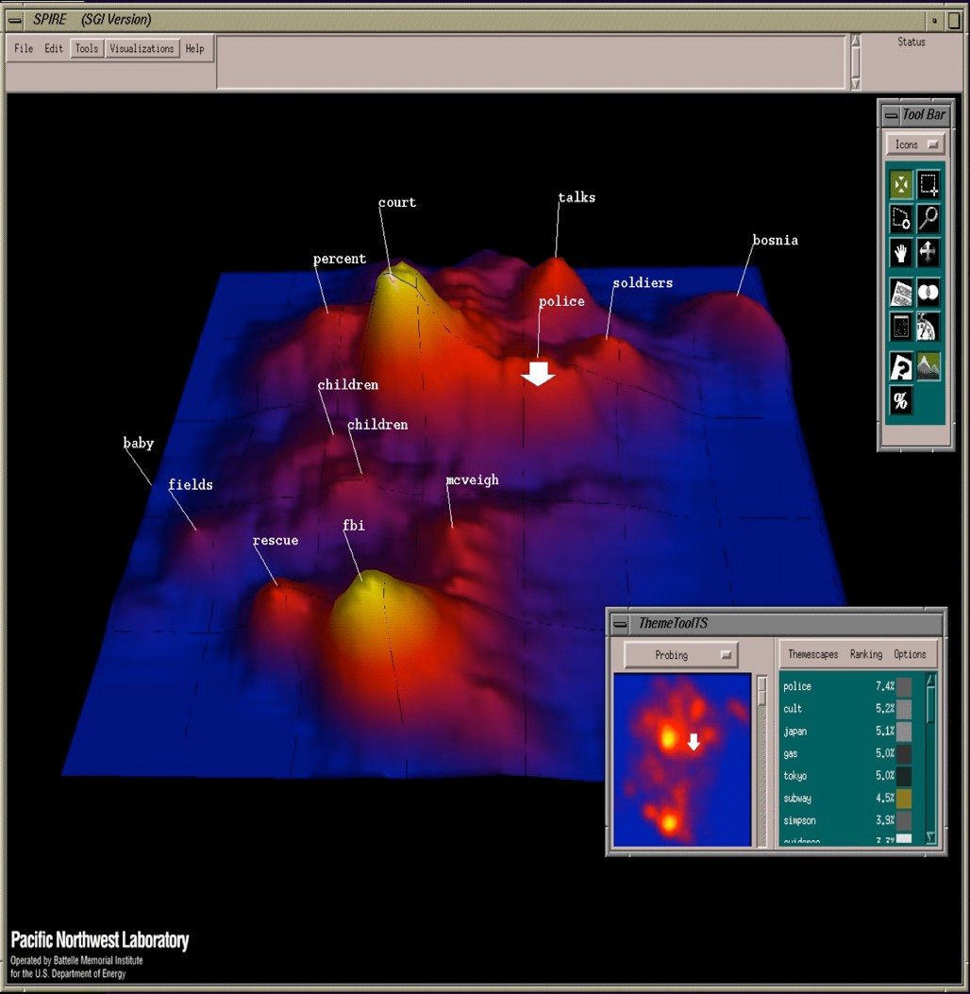
(Incomplete) History of Visual Analytics: 1990s
Information visualization, storytelling
Starting to think about: online spaces, interaction

Slide 13
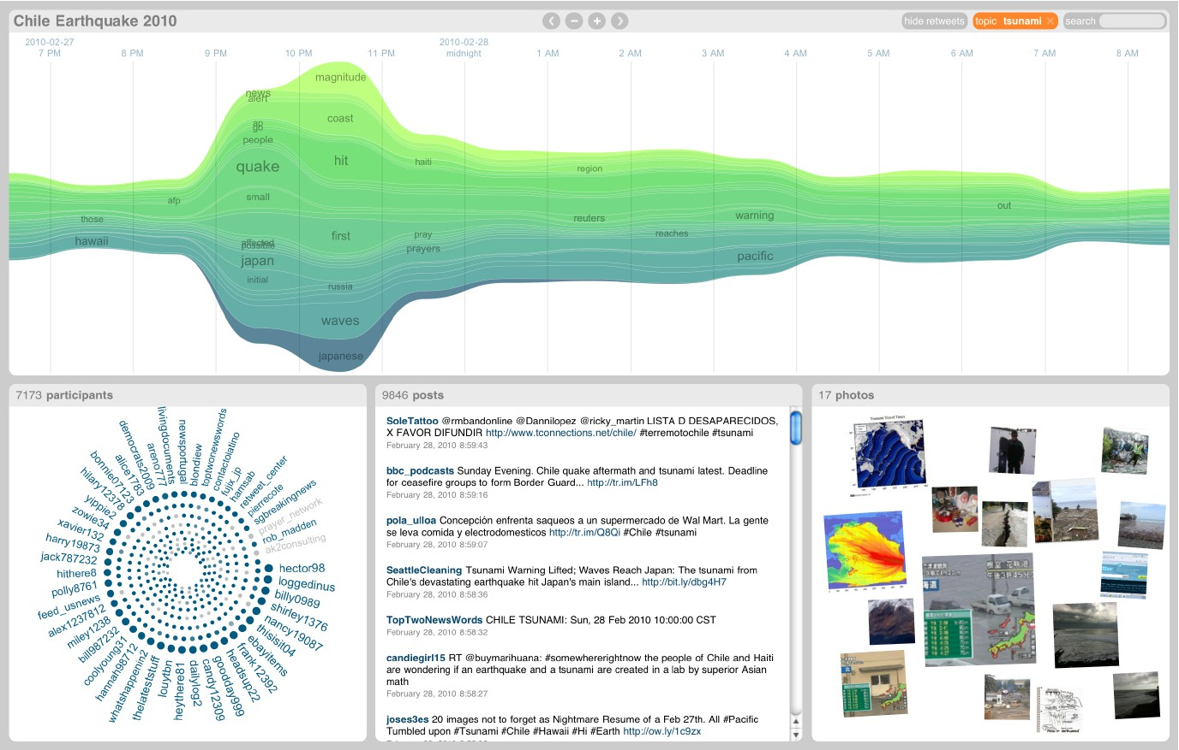
(Incomplete) History of Visual Analytics: 2000s
Coordination across multiple views, interaction
Starting to think about: sensemaking, provenance

Slide 14
(Incomplete) History of Visual Analytics
Early 2000s: US is reacting to 9/11
2003: Dept. of Homeland Security (DHS) est.
DHS objectives:
Prevent terrorist attacks within the US
Reduce US vulnerability to terrorism
Minimize damage / aid recovery from attacks that do occur
2005: DHS charters the National Visualization and Analytics Center (NVAC) at PNNL

Slide 15
(Incomplete) History of Visual Analytics
NVAC mission:
Develop advanced information technologies to support the Homeland Security mission with data that is massive, complex, incomplete, and uncertain in scenarios requiring human judgment.
Challenges:
How do we support analytical reasoning under complex, changing circumstances?
How do we make use of domain expertise, when domain experts are not computer scientists?
New idea: (visualization) ∩ (analytics)

Slide 16
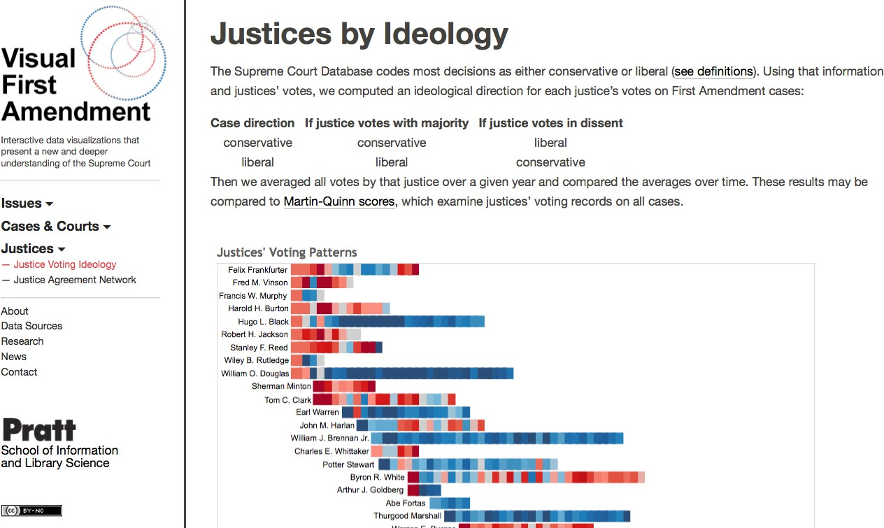
(Incomplete) History of Visual Analytics: 2010s
Human-machine collaboration, machine learning
Starting to think about: evaluation, new media, DH

Slide 17
Outline
Introductions
Big problem
Quick history lesson
Visual analytics: definition
Discussion: how does it help?
Structure of this course

Slide 18
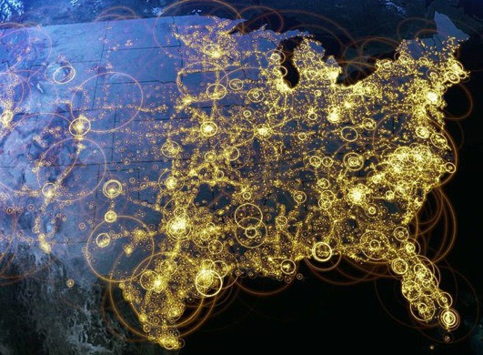
Visualization (def.)
Creating visual representations of data to reinforce human cognition

Slide 19

Analytics (def.)
Discovery and communication of meaningful patterns in data

Slide 20
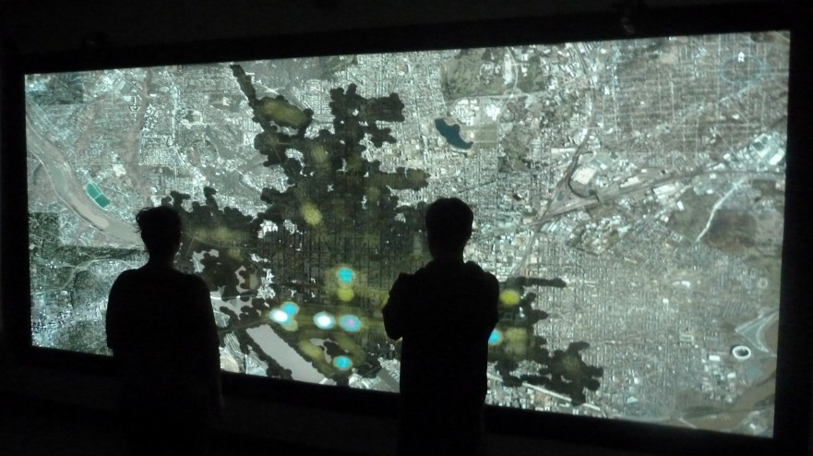
Visual Analytics (def.)
“The science of analytical reasoning
facilitated by interactive visual interfaces”¹
¹Thomas, James J., and Kristin A. Cook, eds. Illuminating the path: The research and development agenda for visual analytics. IEEE Computer Society Press, 2005.

Slide 21


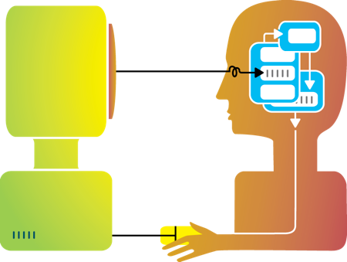
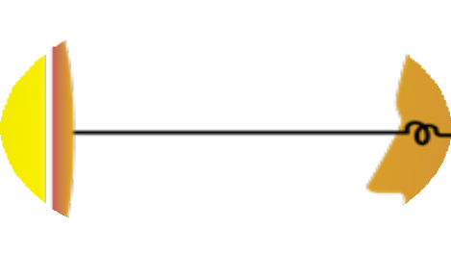





Big idea
Humans and machines have complimentary strengths
Visualization
Perception
and context
Interaction
Computational power
Image credit: Ali Ansari

Slide 22
VA: Human + Machine Collaboration
Make use of what both humans and machine strengths using interactive visual interfaces to facilitate the “conversation”
Key considerations:
Traditional analytics (stats, machine learning) can help make massive data tractable
Use what we know about cognition and perception
to help humans put data in context

Slide 23

How does this help?
Idea 1:
do things more efficiently

Slide 24






Case study: modeling political unrest
Visualization Applications and Design Studies
Two Visualization Tools for Analyzing Agent-Based
Simulations in Political Science
R. Jordan Crouser and Daniel E. Kee ■ Tufts University Dong Hyun Jeong ■ University of the District of Columbia Remco Chang ■ Tufts University
lab^{R}taro ^{s}oni^{oifm},^{1utenla}c^{u}on^{tesea}fl^{sn}ic^{ad}t^{ge2},^{enxtp}v^{l}iole^{or-basee}nc^{bde}e^{m3},^{avh od}aºn^{r}d^{ielisnsg}p^{u}op^{(cAh}u^{Ba}l^{M}ta^{s )}ion^{col-to} ics^{witT}t^{h}o^{o h}olºs^{m}ot^{delp aaid}supp^{ndreexs}or^{pset}t^{rh}a^{st e}n^{ste}aºly^{cd}si^{eha}s^{ve}of^{lleop}a^{l nge}ge^{tsw}nt-ba^{o, wevicsu}es^{ola}d^{lal b}mo^{aonra}de^{alyte}l^{t}s^{-d}
esearch in the social and behavioral sciences simulation runs into a single, cohesive overview.
change.⁴ Researchers have also used agent-based in political science. With MDSVis (Multidimen- models to identify a country’s political patterns, sional Scaling Visualization), analysts can explore which might indicate the imminence of civil un- the simulation space, finding similar patterns at an rest and help predict catastrophic events.⁵ ABM aggregated level and finding the dominant factors
represents a behavioral system as a collection of affecting agent behavior. With
autonomous entities or agents. Each agent inter- SocialVis, analysts can focus on _{MDSVis (Multidimensional}
acts with other agents according to a set of rules one simulation run, exploring
and goals, and over time it might influence and be relationships between time steps ^{Scaling Visualization) lets}
influenced by the agents around it. and geographic regions.
As increased computing power becomes more
widely available, scientists can simulate more com- Domain Characterization
analysts explore the simulation space of agent-based models, finding similar patterns at an
plex systems, which in turn generate substantially Through behavioral-simulation aggregated level and finding larger datasets that must then be analyzed and in- analysis, scientists seek to un- the dominant factors affecting terpreted. Unfortunately, the methods and tools cover the sociopolitical and so- agent behavior. SocialVis
available to social scientists for analyzing simula- cioeconomic forces that control _{lets analysts narrow their}
tion results can’t support datasets of such magni- and influence group behaviors analysis to a single simulation tude, making it difficult for scientists to effectively and to predict behavioral pat- _{run, exploring relationships} interpret and analyze the results.⁶ terns using real-world data. A _{between time steps and}
In addition, ABM is a stochastic simulation better understanding of how _{geographic regions.}
technique, using small random perturbations to these forces influence group be- the interaction rules and running each simulation havior and the ability to make
hundreds or even thousands of times to avoid local more accurate predictions can greatly influence minima and to generate a distribution of sample how we view real-world behavioral systems and behavioral patterns. Analysts must therefore be better inform decisions regarding domestic sta- able to compare simulated behaviors between and bility, foreign policy, and more.
across distinct runs and to piece together many The first step in this process is constructing an
Published by the IEEE Computer Society 0272-1716/12/$31.00 © 2012 IEEE
IEEE Computer Graphics and Applications
67

Slide 25


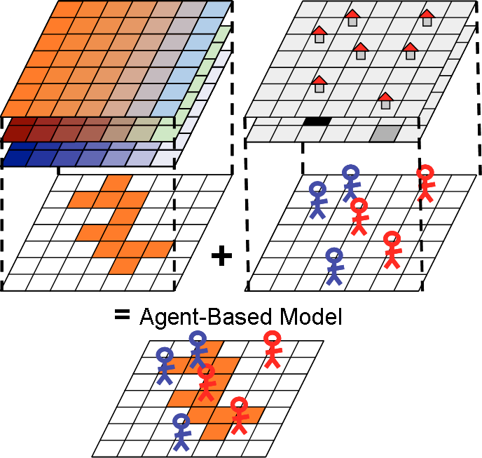
Case study: modeling political unrest
ABM image credit: Rebaudo, François, et al.

Slide 26





“Best practice”

Slide 27





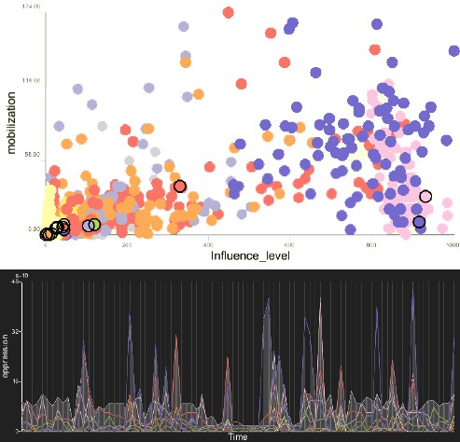
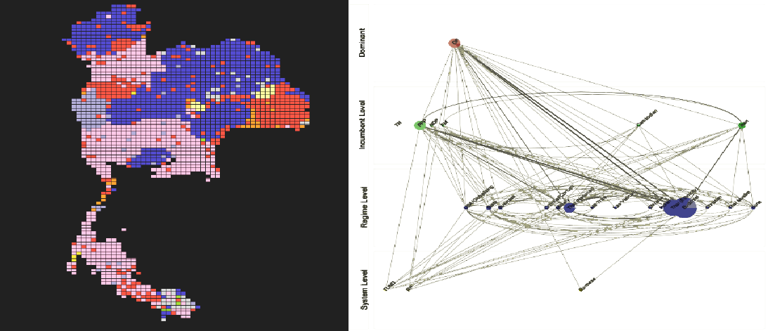




A different approach: SocialVis
Bubble Chart: correlation between
mobilization and influence
DPH View: custom “dynamic political hierarchy” visualization
Timeline: activities of each group over time
Geospatial View: geospatial position and affiliation of all agents
Crouser, R. Jordan, et al. "Two visualization tools for analyzing agent-based simulations in political science." IEEE computer graphics and applications 32.1 (2012): 67-77.

Slide 28

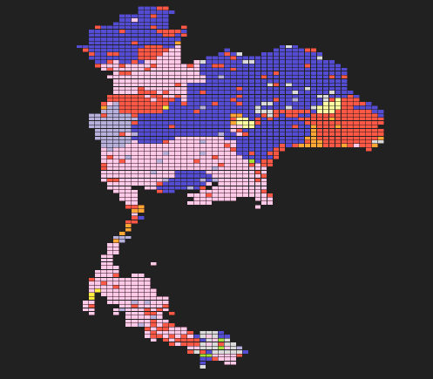
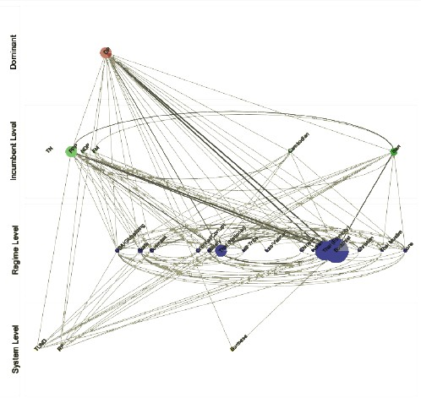
Better!

Slide 29
Idea 1:
do things more efficiently

Slide 30
How else does this help?
Idea 2:
see the bigger picture

Slide 31

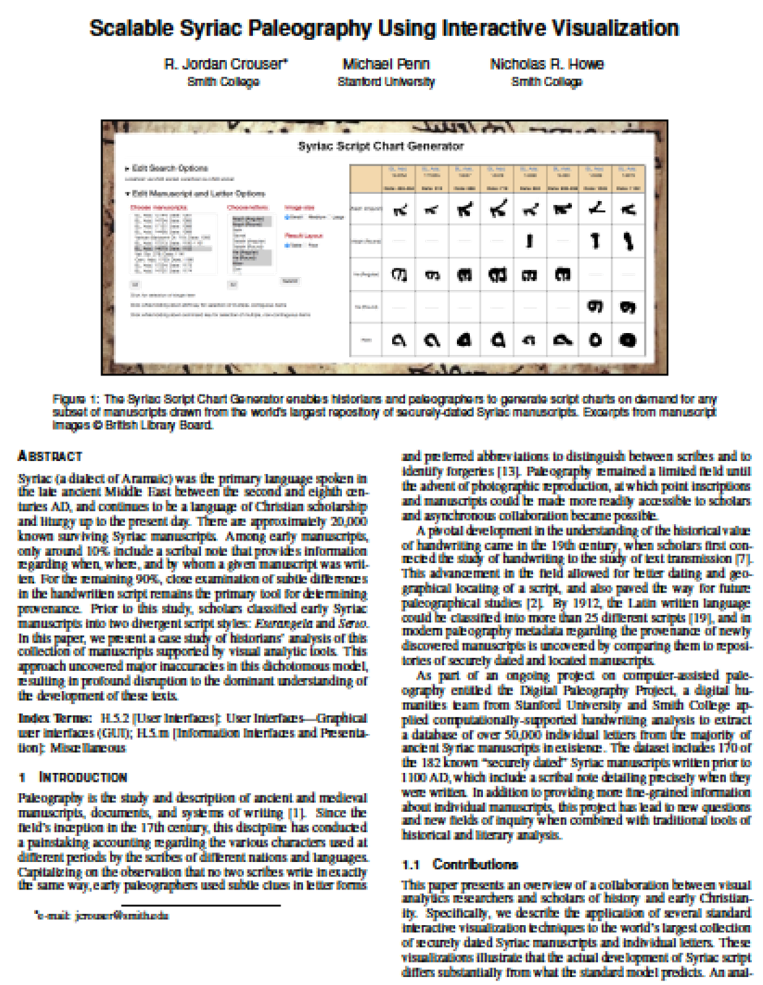


Case study: Syriac Paleography

Slide 32
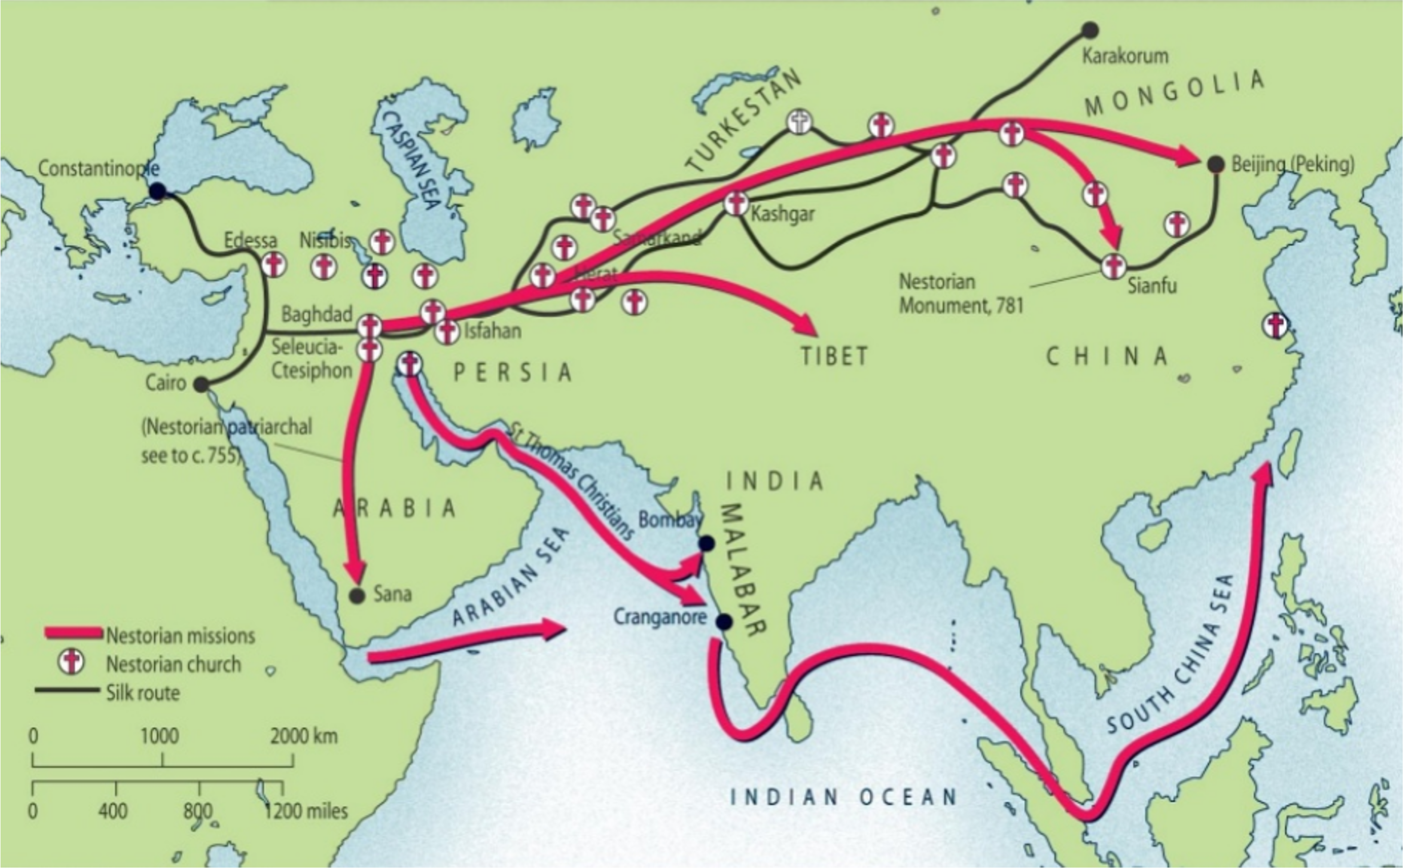
Historical significance

Slide 33


One language, two hands
Estrangela
Serto
British Library Additional 14,430 (724 AD)
British Library Additional 14,734 (1085 AD)

Slide 34
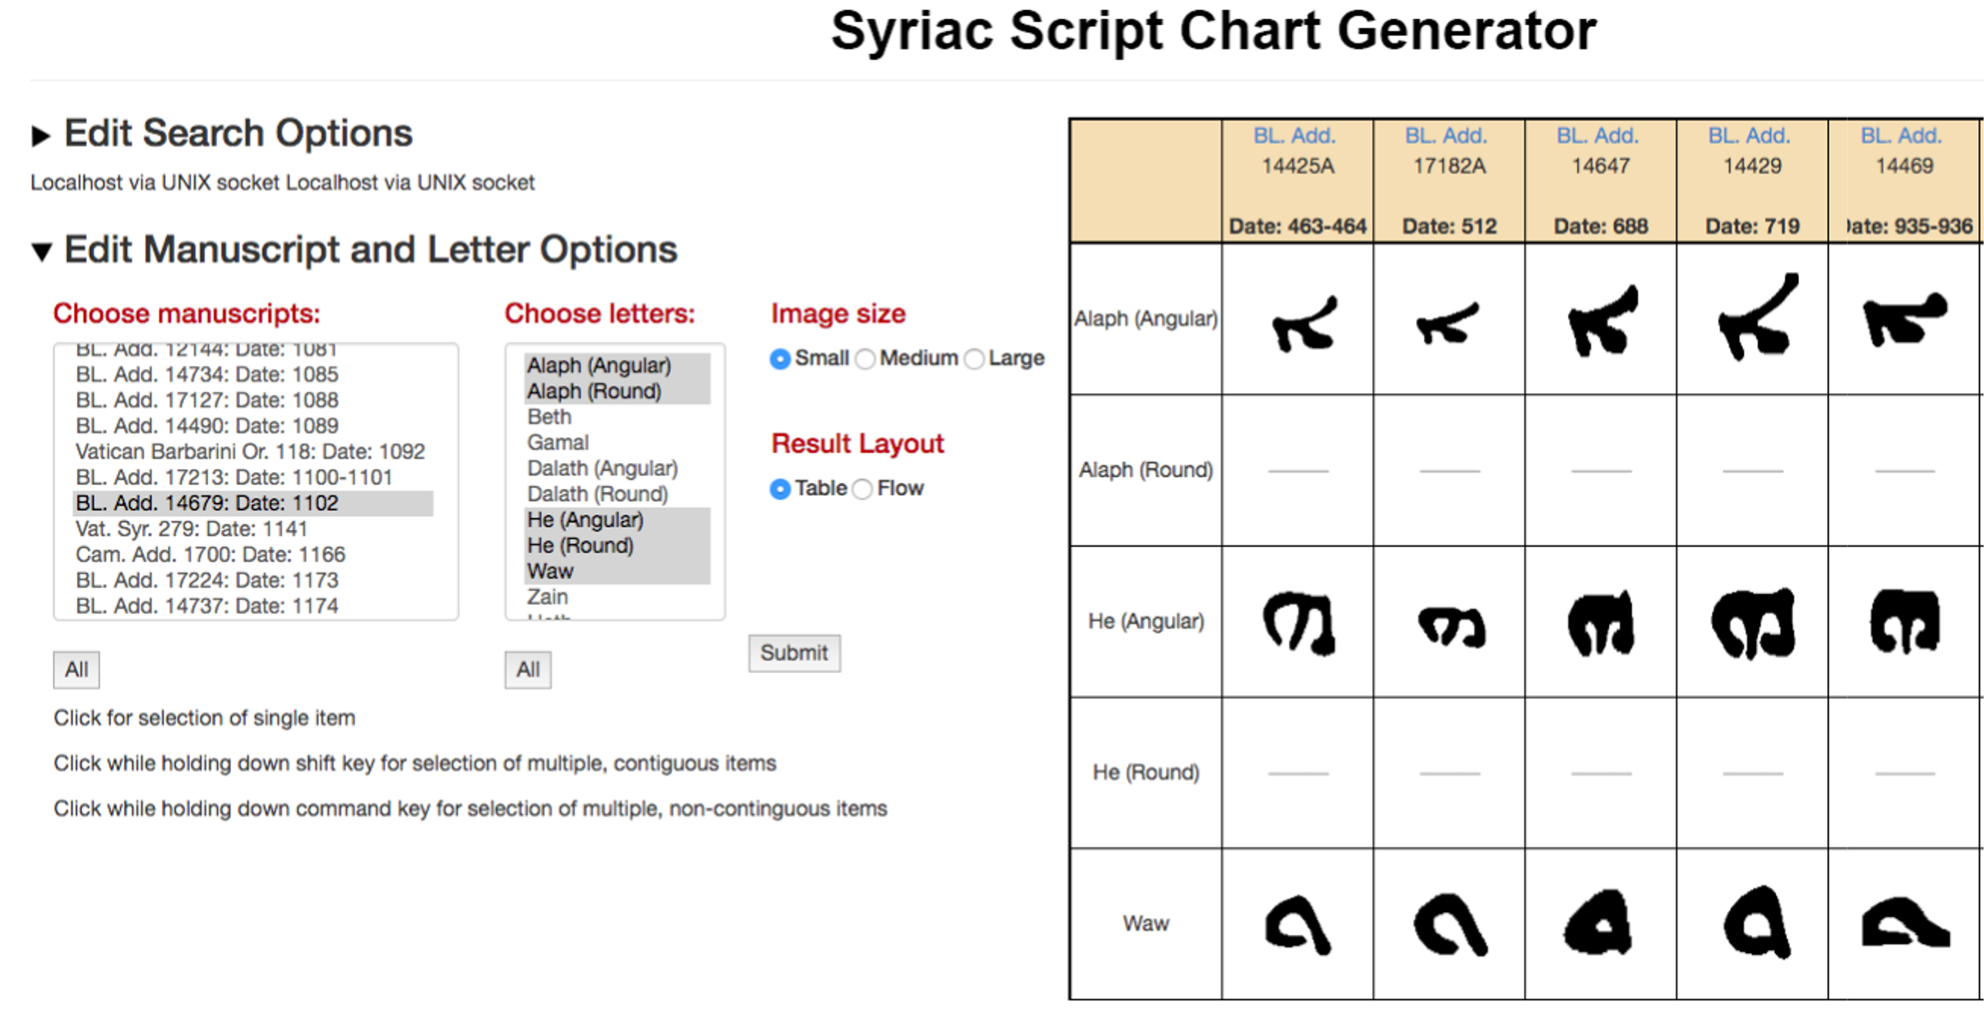
The “script chart”

Slide 35
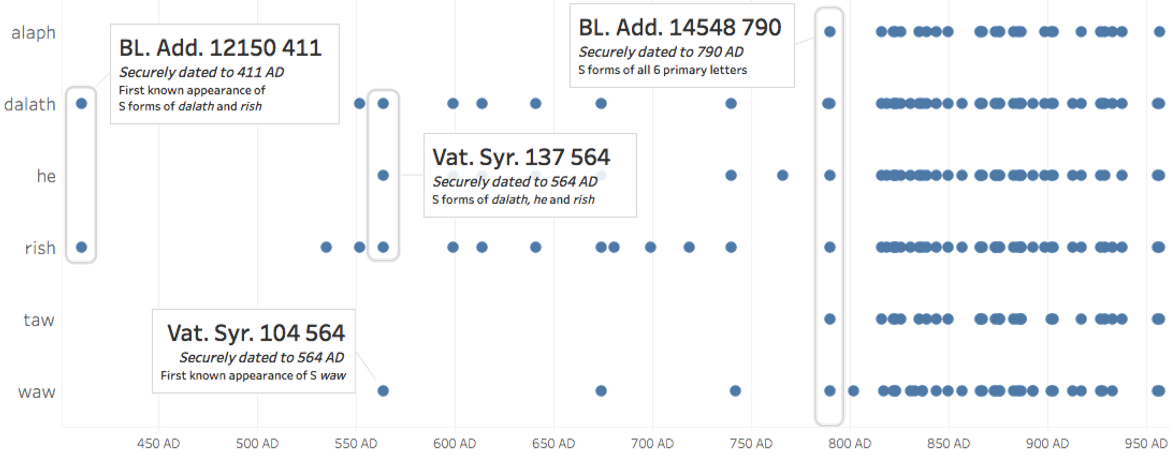
Myth 1: Serto first appeared in the 8th century

Slide 36
Myth 2: manuscripts are written in either E or S

Slide 37
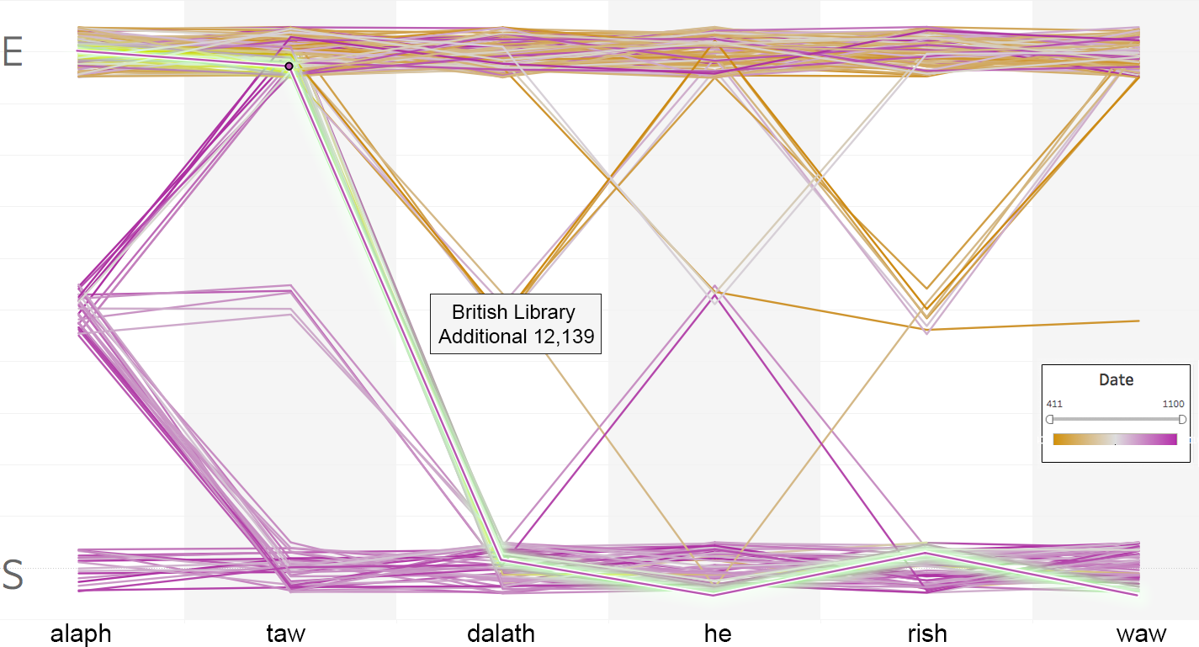
Myth 3: individual letters in either E or S

Slide 38
Idea 2:
see the bigger picture

Slide 39
How else does this help?
Idea 3:
avoid getting stuck

Slide 40



Case Study: Computing for Mental Health
A. Metaxa-Kakavouli ‘20, J. Chung ‘20, I. Raut ’17 MHC
Image credit: National Alliance for Mental Illness (NAMI)

Slide 41
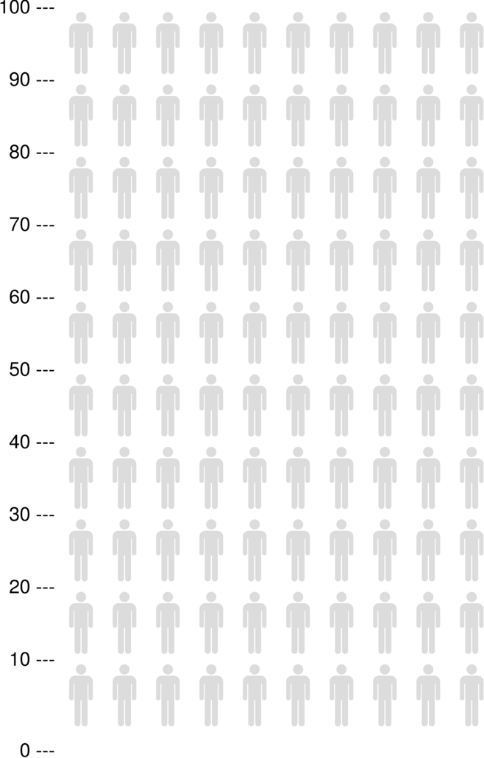
Out of 100 mental healthcare
providers in the US…
Data from the US Bureau of Labor Statistics, 2015 Occupational and Employment Statistics Data available at: www.bls.gov/oes

Slide 42
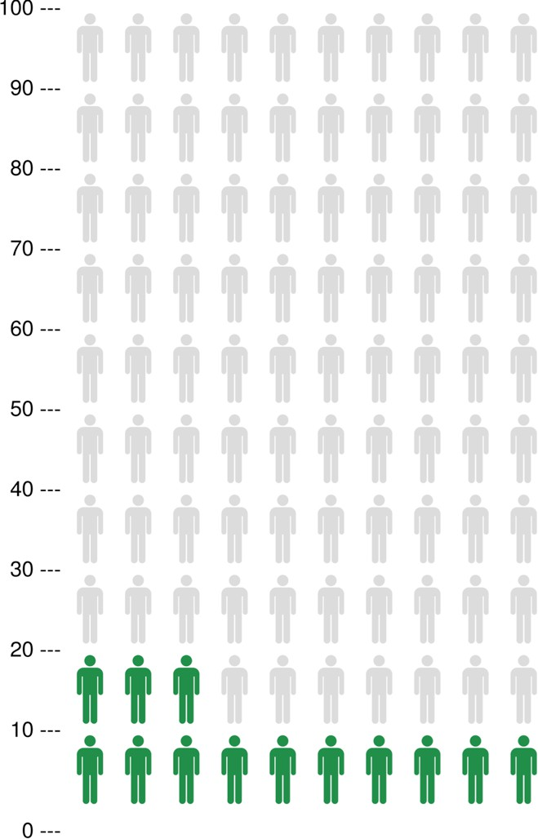
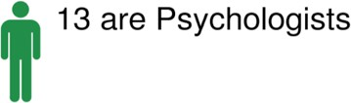
Out of 100 mental healthcare
providers in the US…
Data from the US Bureau of Labor Statistics, 2015 Occupational and Employment Statistics Data available at: www.bls.gov/oes

Slide 43
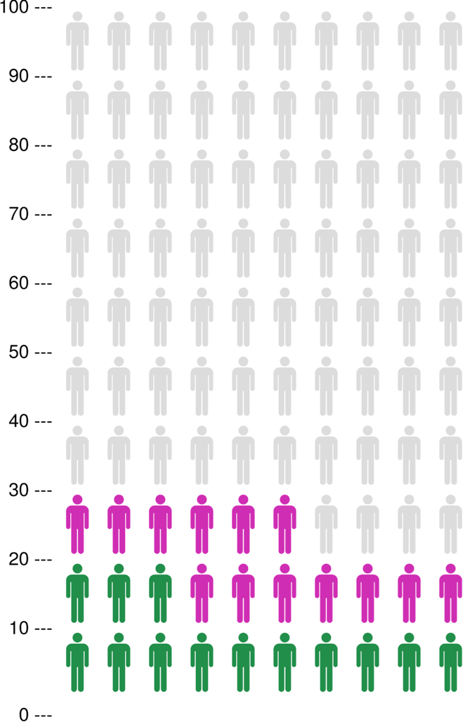
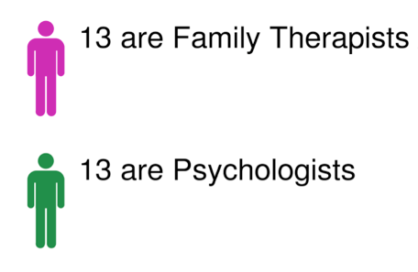

Out of 100 mental healthcare
providers in the US…
Data from the US Bureau of Labor Statistics, 2015 Occupational and Employment Statistics Data available at: www.bls.gov/oes

Slide 44
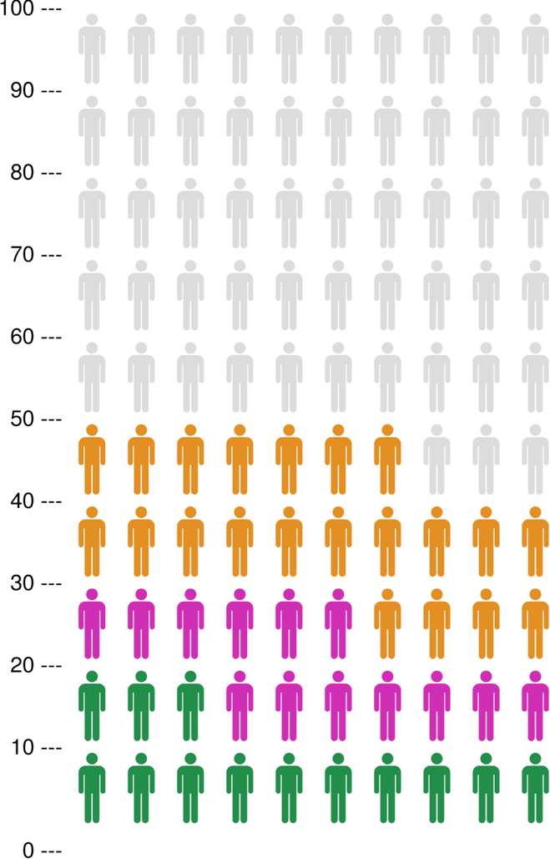
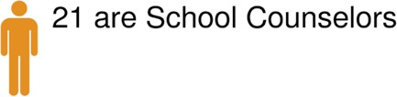
Out of 100 mental healthcare
providers in the US…
Data from the US Bureau of Labor Statistics, 2015 Occupational and Employment Statistics Data available at: www.bls.gov/oes

Slide 45
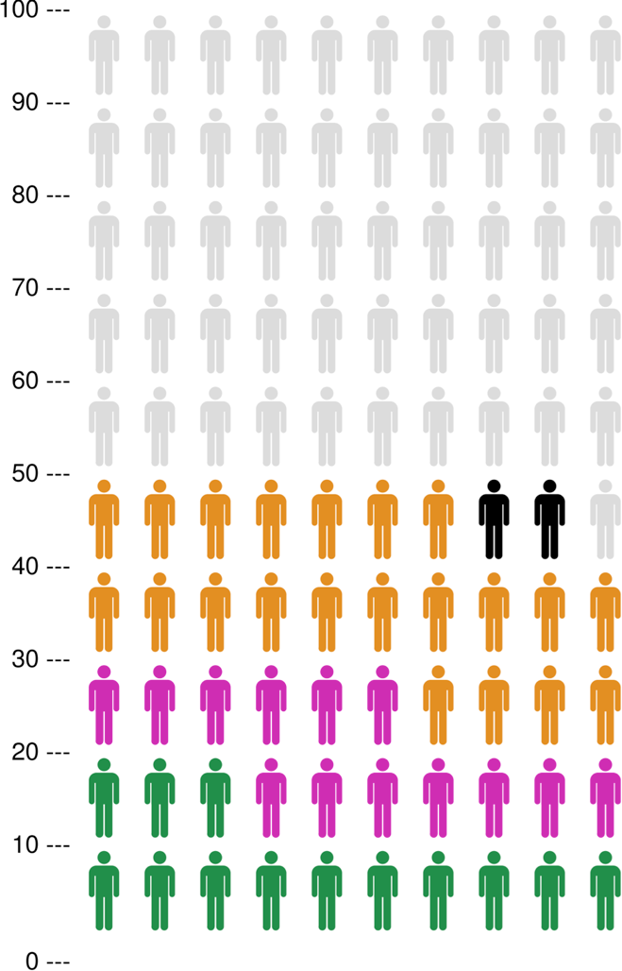
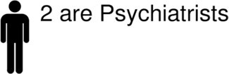
Out of 100 mental healthcare
providers in the US…
Data from the US Bureau of Labor Statistics, 2015 Occupational and Employment Statistics Data available at: www.bls.gov/oes

Slide 46
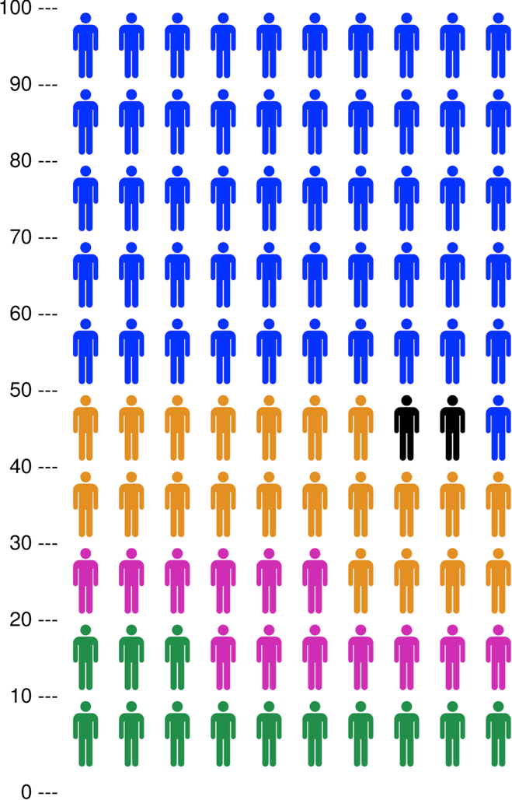
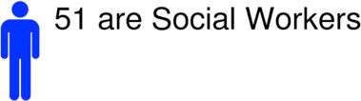
Out of 100 mental healthcare
providers in the US…
Data from the US Bureau of Labor Statistics, 2015 Occupational and Employment Statistics Data available at: www.bls.gov/oes

Slide 47






Out of 100 mental healthcare
providers in the US…

Slide 48


Slide 49
Data from the US Bureau of Labor Statistics, 2015 Occupational and Employment Statistics Data available at: www.bls.gov/oes

Slide 50

Data from the US Bureau of Labor Statistics, 2015 Occupational and Employment Statistics Data available at: www.bls.gov/oes

Slide 51
Out of 100 mental healthcare
providers in the US…
Problem:
Social work doesn’t approach mental health the same way psychiatry does
Data from the US Bureau of Labor Statistics,
2015 Occupational and Employment Statistics
Data available at: www.bls.gov/oes

Slide 52

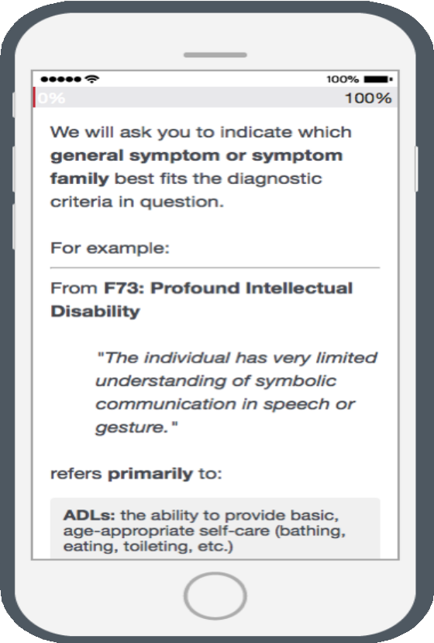
Step 1: data collection

Slide 53
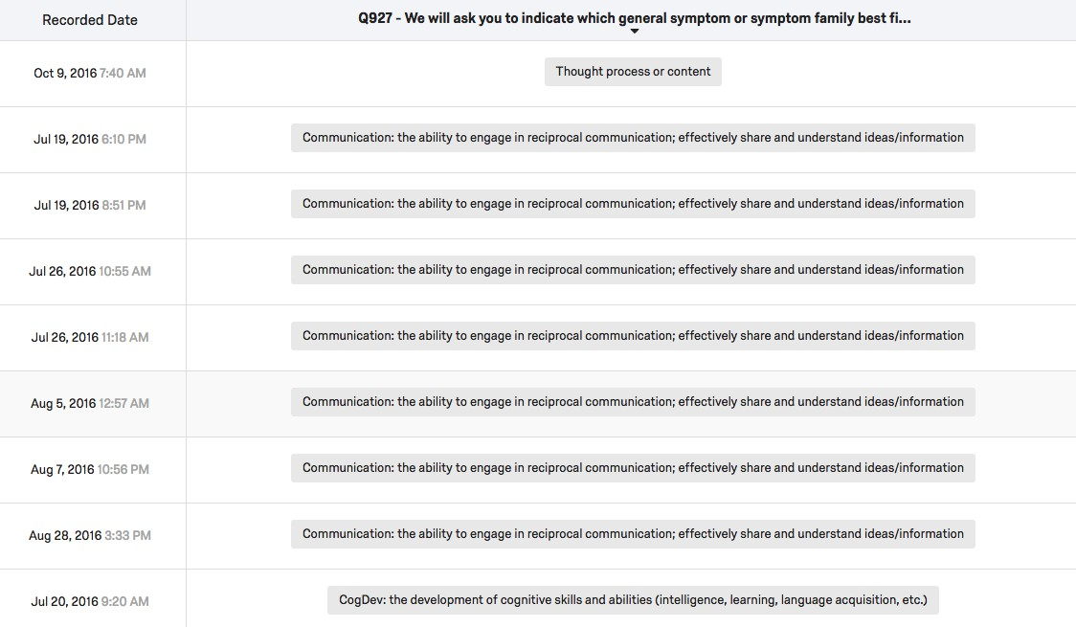
Step 2: data mining

Slide 54
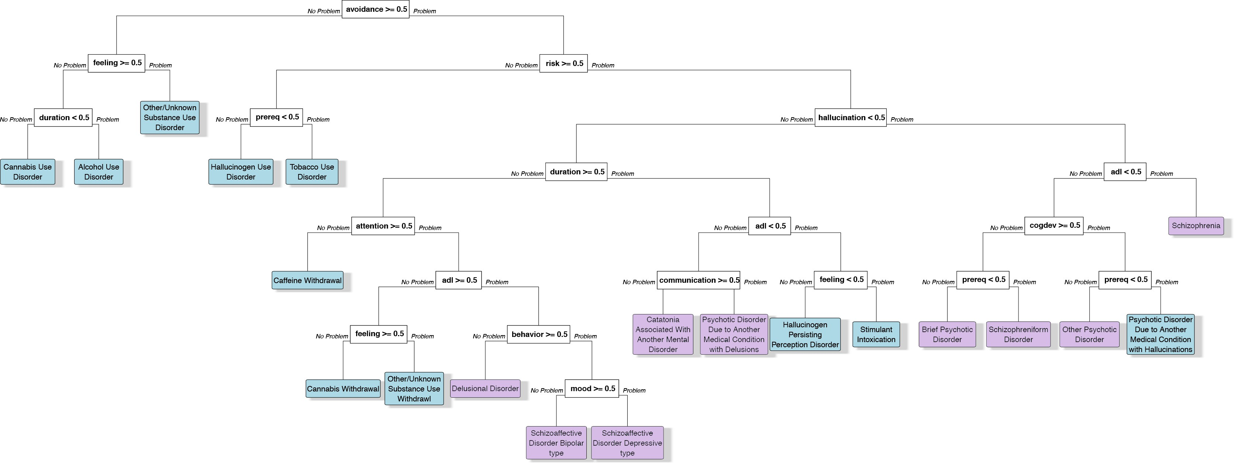
Step 2: data mining

Slide 55
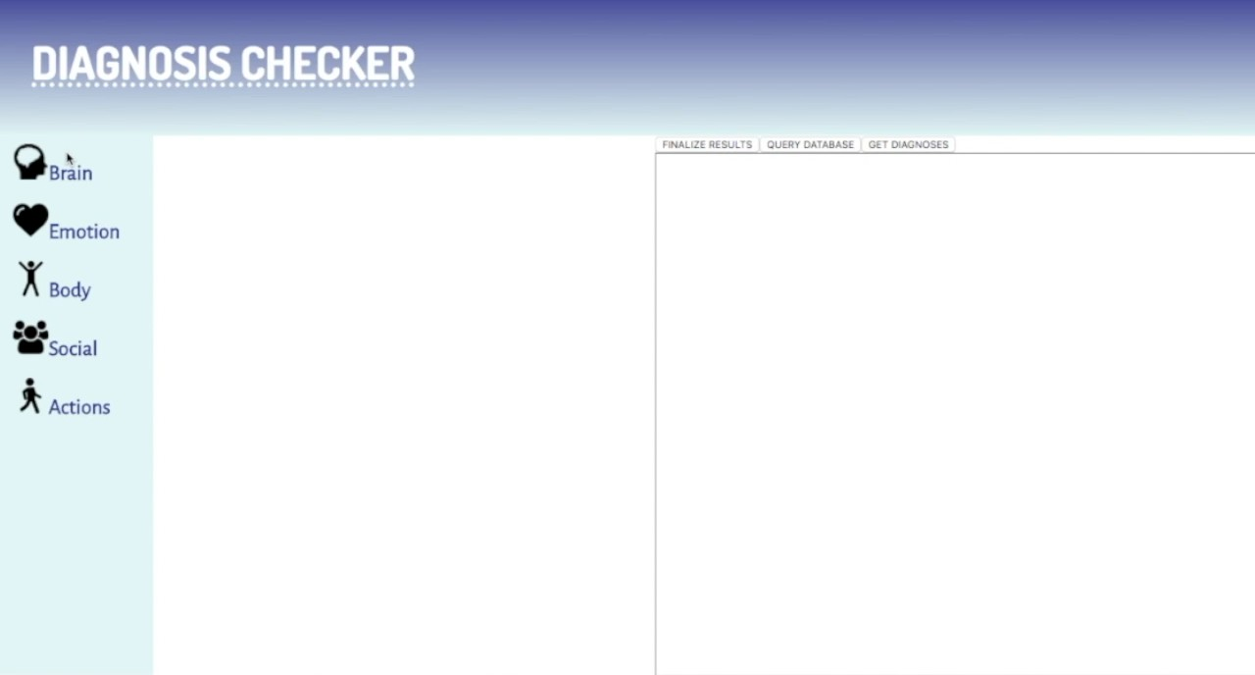
Step 3: make accessible

Slide 56
Idea 3:
avoid getting stuck

Slide 57
Outline
Introductions
Big problem
Quick history lesson
Visual analytics: definition
Discussion: how does it help?
Structure of this course

Slide 58
Structure of this course
Disclaimer:
this course is an experiment in
constructionism
(the idea that people learn most effectively when they’re building personally-meaningful things)

Slide 59
What we’ll cover
Unit 1: Foundations
Next Class: Mental and Visualization Models
Data Wrangling and Modeling 101
Data Visualization 101
Interaction
Coordinating Multiple Views
Unit 2: The Real Fun Starts
Quirky data (time-varying data, geospatial data, networks)
Scalability
Color and Visual Channels
High-dimensional data
Unit 3: Ongoing Research
Provenance
Uncertainty
Prediction and Recommendation

Slide 60
What we WON’T cover
CSC foundations:
Editors (vim, emacs, etc.)
Version control (git)
Debugging and profiling
Python basics
SDS foundations:
Data collection
Databases and storage
Regression, etc.
R basics
Important note: VA systems are rarely built by a single person! You don’t need to have mastered all these skill, just try to make some friends who have complementary experience ©

Slide 61
Assignments and Grading
Participation & Engagement (10%):
Zoom in and / or watch the recordings, engage on Slack, and you’ll be fine
Data Challenges (30%):
New dataset introduced in lecture, along with guiding questions
Working in teams of ~5: wrangle, explore, visualize, report back!
Critical Reflections (20%):
VA is an emerging field, and new research is always forthcoming
Throughout the semester, I’ll assign a few key papers to read and ask you to reflect on what you read
Common format: Medium.com (creative alternatives are welcome!)
10-minute presentation on an existing VA system (10%):
You pick the topic: any real-world application is fair game!
Goal: get a sense for what’s out there in the VA research world
Course project (30%)

Slide 62
Course Project
Goals:
Learn how to break big, unwieldy questions down into clear, manageable problems
Figure out if/how the techniques we cover in class apply to
your specific problems
Build VA systems to address them
Data options
Compete in the VAST Challenge (annual VA competition)
Various industry partners (VIPs) will be pitching potential datasets and/or analysis questions
You’re also welcome to propose your own!
Several (graded) milestones along the way
Demos during the final week of class

Slide 63
What you’ll get
By the end of this course, you will:
Understand what Visual Analytics is
Know the foundational methods and tools available
Be familiar with some ongoing research in VA
Be able to perform analyses and report your findings
Engage with guest speakers from really cool places
Have (marketable!) experience developing useful visual analytics applications for real data

Slide 64
What I expect from you
You enjoy grappling with difficult problems, and you’re excited about “figuring stuff out”
You are (or are willing to work to become) proficient in programming and debugging
We’ll do crash courses in a few key topics, but this is NOT a course intended to teach you general programming techniques
You’re welcome to work in whatever language(s) you prefer, but I’m more helpful in the ones I know ©
You’re comfortable asking questions

Slide 65
What you can expect from me
I’m flexible w.r.t. the topics we cover:
This course is a collaboration
If there’s something you want to learn that’s not on the agenda, speak up!
I’m happy to share my professional connections:
If there’s a company or school you’d like to work with for your project, let me know and I’ll reach out to them
Note: the best way to get a job/internship/etc. is to convince someone on the inside that you’re awesome
Downside: I have ~130 students this semester
My commitment: if you ping me on slack during business hours, you’ll get a response by the end of the day
Pandemic parenting = limited availability after hours

Slide 66



Resources: course website & syllabus
jcrouser.github.io/CSC235

Slide 67


Resources: slack (all communication)
smi-csc-sds235-01.slack.com

Slide 68


Resources: moodle (lecture notes, hw)
moodle.smith.edu

Slide 69
Before next class:
Fill out your 3-minute bio (if you haven’t already)
Make sure you can access moodle
Join the 235 slack team:
smi-csc-sds235-01.slack.com
Update your Slack profile to include:
- Your name (the one you want us to use)
Pronouns
A photo (of you, preferably)

